Slide 1
Image Histogram
By-
Abhinaba Chowdhury
Abhiroop Mukherjee
Debarghya Dey
Jyotiprakash Roy
Shrutanten

Slide 2
1.) What is Histogram Equalization?
Histogram Equalization is a computer image processing technique used to improve contrast in images. It accomplishes this by effectively spreading out the most frequent intensity values, i.e. stretching out the intensity range of the image. This method usually increases the global contrast of images when its usable data is represented by close contrast values. This allows for areas of lower local contrast to gain a higher contrast.

Slide 3
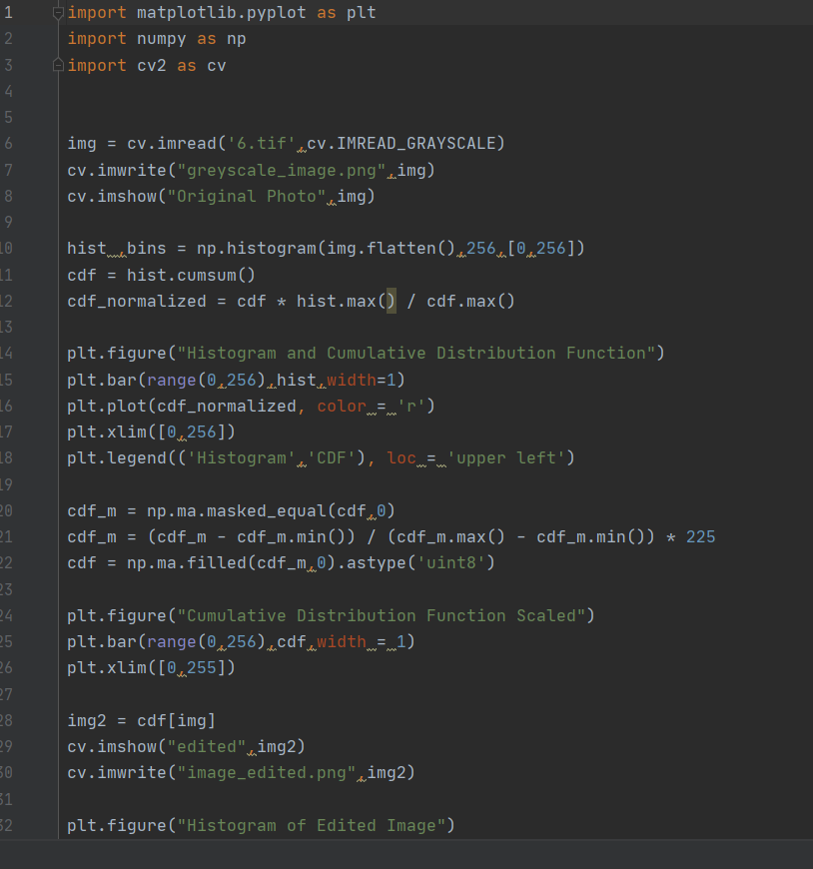
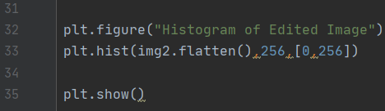
1.) Histogram Equalization without using open source library function (Python Code) :-

Slide 4
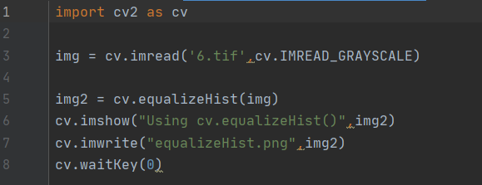
1.) Histogram Equalization using open source library function (Python Code) :-

Slide 5
1.) Histogram Equalization (Python Code Explanation) :-
Not using open source library function :-
cdf = hist.cumsum()
-produces cumulative sum of bins
cdf_normalized = cdf * hist.max() / cdf.max()
-resizes the cdf to the range [0, hist.max()]
-only used for showing cumulative Histogram and histogram side by side, no use in actual processing
cdf_m = np.ma.masked_equal(cdf,0)
cdf_m = (cdf_m - cdf_m.min()) / (cdf_m.max() - cdf_m.min()) * 225
cdf = np.ma.filled(cdf_m,0).astype('uint8’)
-does similar thing as (2), but ignores zero value to better fit the cumulative histogram
-ranges of output value [0,225]
-also fixes the type of data to uint8
Using open source library function :-
img2 = cv.equalizeHist(img)
-OpenCV implementation of Histogram Equalization

Slide 6
1.) Histogram Equalization (Image 5) :-
The original image

Slide 7
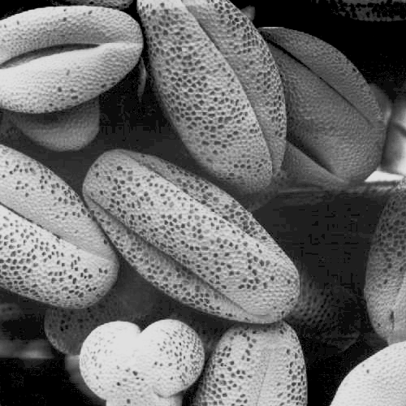
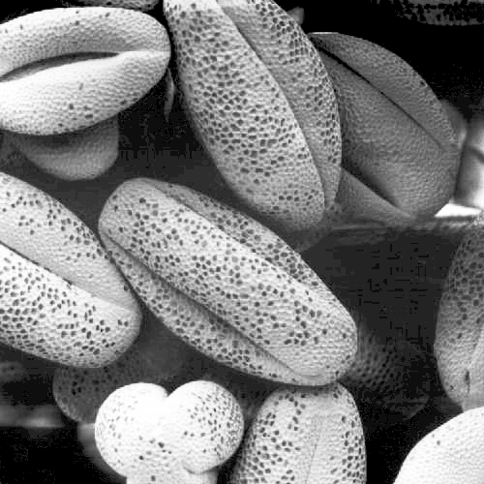
1.) Histogram Equalization (Image 5) :-
Edited by implemented code Edited by open source library function

Slide 8
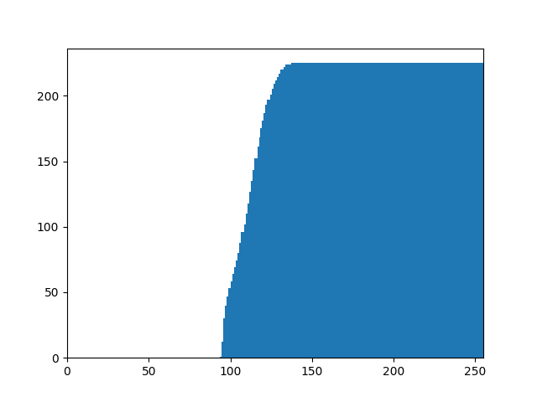
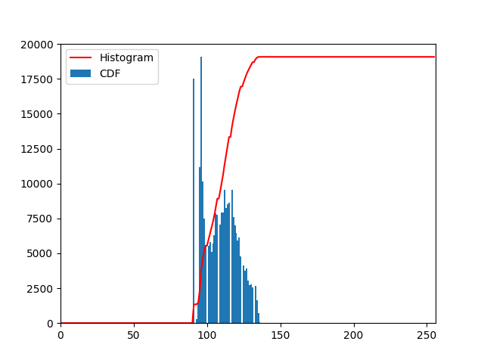
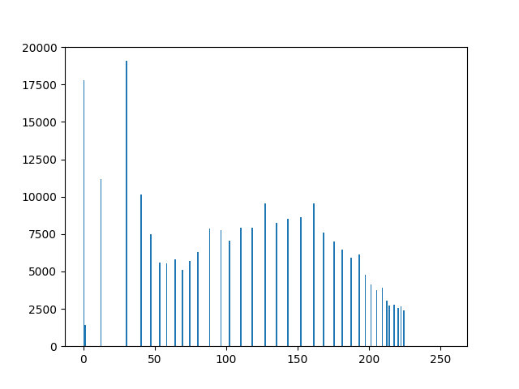
1.) Histogram Equalization (Image 5) :-
CDF Scaled Histogram and CDF Histogram of edited image

Slide 9
1.) Histogram Equalization (Image 6) :-
The Original Image

Slide 10


1.) Histogram Equalization (Image 6) :-
Edited by implemented code Edited by open source library function

Slide 11
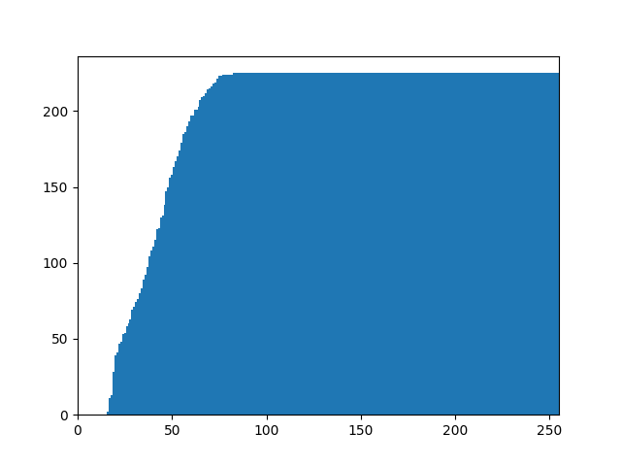
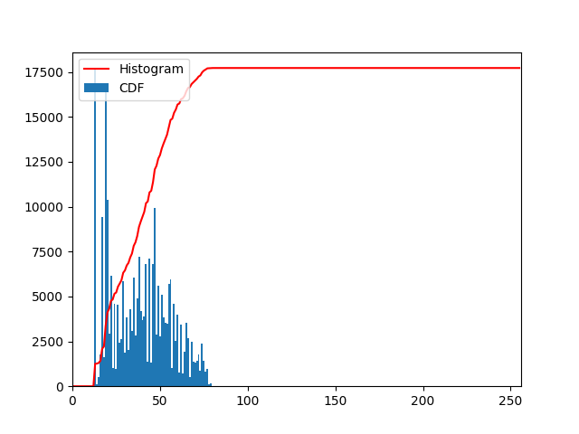
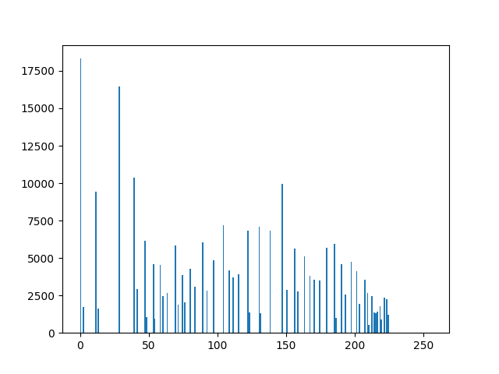
1.) Histogram Equalization (Image 6) :-
CDF Scaled Histogram and CDF Histogram of edited image

Slide 12
2.) What is Salt-and-Pepper Noise?
Salt-and-pepper noise is a form of noise sometimes seen on images. It is also known as impulse noise. This noise can be caused by sharp and sudden disturbances in the image signal. It presents itself as sparsely occurring white and black pixels. And hence the name salt and pepper.
An effective noise reduction method for this type of noise is a median filter or a morphological filter For reducing either salt noise or pepper noise, but not both, a contraharmonic mean filter can be effective.
However, here we have used the technique of median filter.

Slide 13
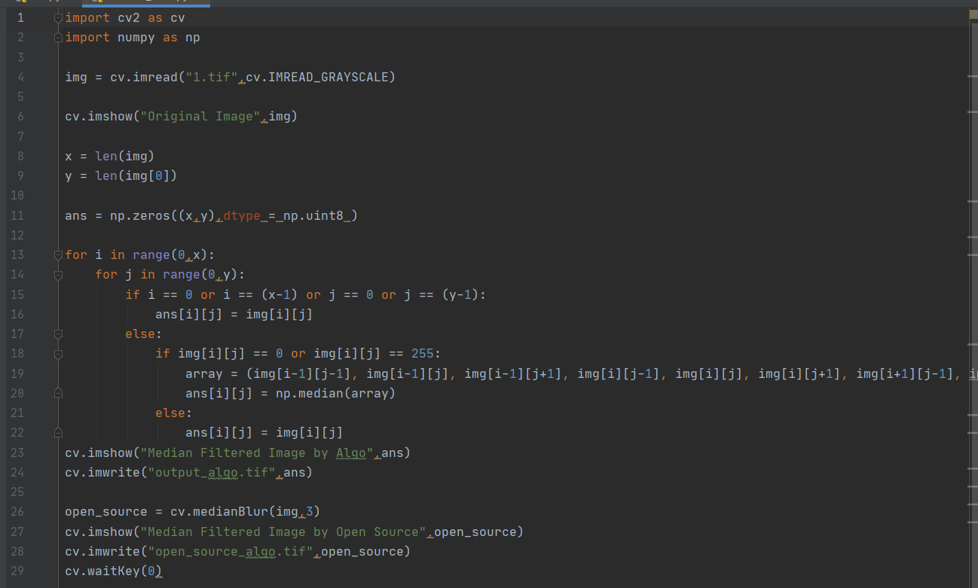
2.) Salt-and-Pepper Noise : python code :-

Slide 14
2.) Salt-and-Pepper Noise : python code explanation :-
Salt and Pepper Noise Removal
array = (img [i-1] [j-1] , img [i-1] [j], img [i-1] [j+1] , img [i] [j-1] , img [i] [j] , img [i] [j+1], img[i+1][j-1] , img [i+1] [j] , img [i+1] [j+1] )
array containing all the element of a 3x3 matrix centred around img [i] [j].
ans[i][j] = np.median(array)
Numpy Median Function, automatically sorts the array and produces median of that sorted array
open_source = cv.medianBlur(img,3)
OpenCV implementation of Median Filter, here 3 is the dimension of the square matrix around img[i][j].

Slide 15
2.) Salt-and-Pepper Noise (Image 1) :-
Original Image By Implemented Code By Open Source Library Function

Slide 16
2.) Salt-and-Pepper Noise (Image 2) :-
Original Image By Implemented Code By Open Source Library Function

Slide 17
2.) Salt-and-Pepper Noise (Image 3) :-
Original Image By Implemented Code By Open Source Library Function

Slide 18
2.) Salt-and-Pepper Noise (Image 4) :-
Original Image By Implemented Code By Open Source Library Function

Slide 19
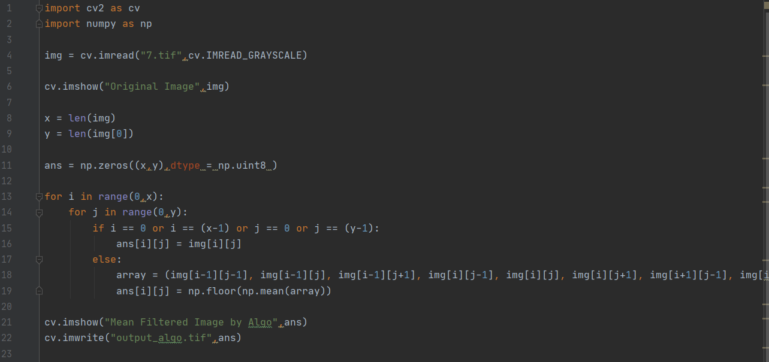
3a.) Noise Correction by Mean Filter :-
Python Code –

Slide 20
3a.) Noise Correction by Mean Filter :-
Python Code Explanation –
ans[i][j] = np.floor(np.mean(array))
assigns ans[i][j] to the floor value of the mean of the array
open_source = cv.blur(img,(3,3))
OpenCV implementation of Mean Filter, here (3,3) is the dimension of the square centred around img[i][j].

Slide 21
3a.) Noise Correction by Mean Filter (Image 1) :-
Original Image Edited Image

Slide 22
3a.) Noise Correction by Mean Filter (Image 2) :-
Original Image Edited Image

Slide 23
3a.) Noise Correction by Mean Filter (Image 3) :-
Original Image Edited Image

Slide 24
3a.) Noise Correction by Mean Filter (Image 4) :-
Original Image Edited Image

Slide 25
3a.) Noise Correction by Mean Filter (Image 7) :-
Original Image Edited Image

Slide 26
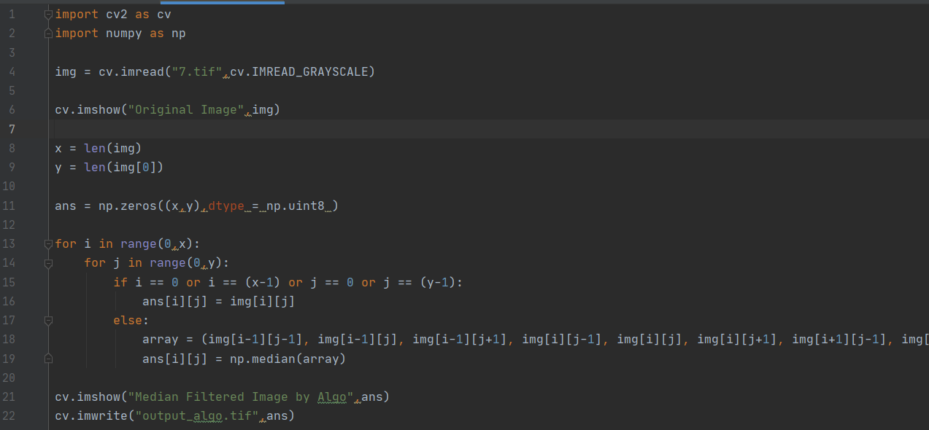
3b.) Noise Correction by Median Filter :-
Python Code -

Slide 27
3b.) Noise Correction by Median Filter :-
Python Code Explanation –
ans[i][j] = np.median(array)
Numpy Median Function, automatically sorts the array and produces median of that sorted array
open_source = cv.medianBlur(img,3)
OpenCV implementation of Median Filter, here 3 is the dimension of the square matrix around img[i][j].

Slide 28
3b.) Noise Correction by Median Filter (Image 1) :-
Original Image Edited Image

Slide 29
3b.) Noise Correction by Median Filter (Image 2) :-
Original Image Edited Image

Slide 30
3b.) Noise Correction by Median Filter (Image 3) :-
Original Image Edited Image

Slide 31
3b.) Noise Correction by Median Filter (Image 4) :-
Original Image Edited Image

Slide 32
3b.) Noise Correction by Median Filter (Image 7) :-
Original Image Edited Image

Slide 33
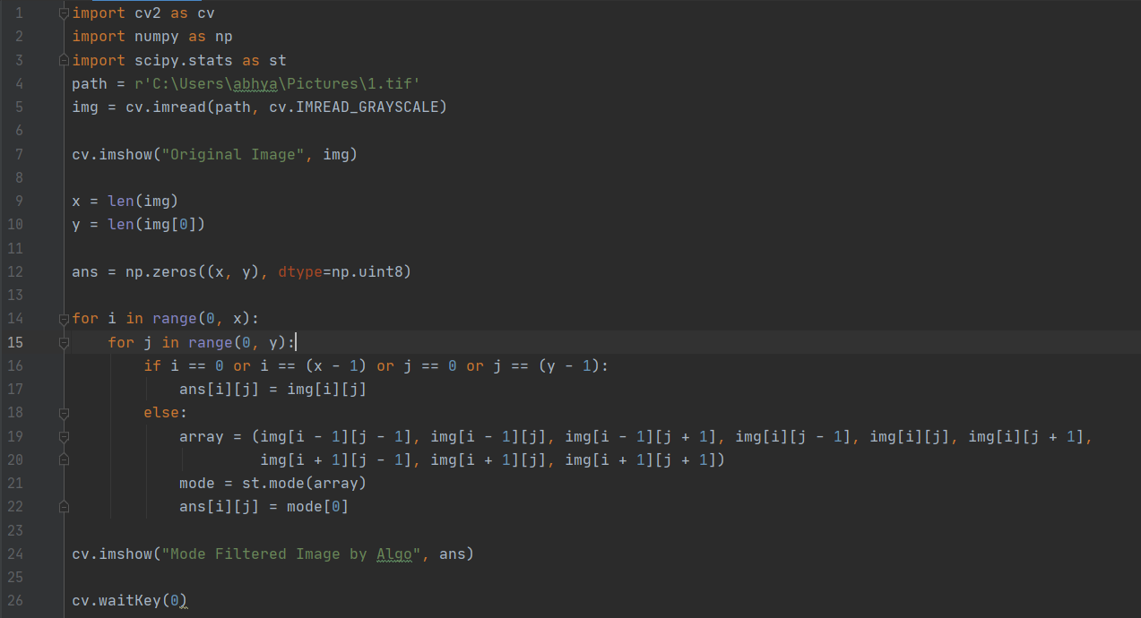
3c.) Noise Correction by Mode Filter :-
Python Code -

Slide 34
3c.) Noise Correction by Mode Filter :-
Python Code Explanation –
mode = st.mode(array)
scipy.stats implementation of mode, gives mode of an array as output

Slide 35
3c.) Noise Correction by Mode Filter (Image 1) :-
Original Image Edited Image

Slide 36
3c.) Noise Correction by Mode Filter (Image 2) :-
Original Image Edited Image

Slide 37
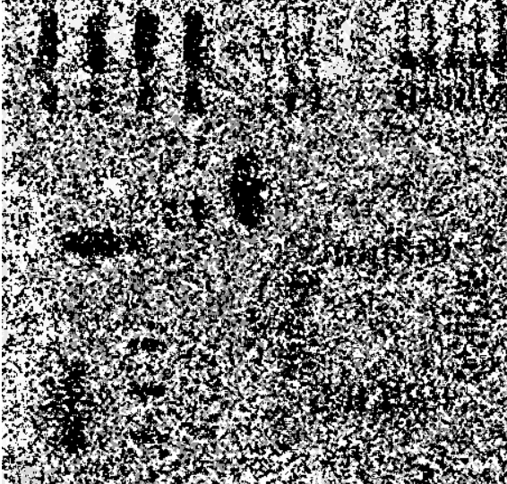
3c.) Noise Correction by Mode Filter (Image 3) :-
Original Image Edited Image

Slide 38
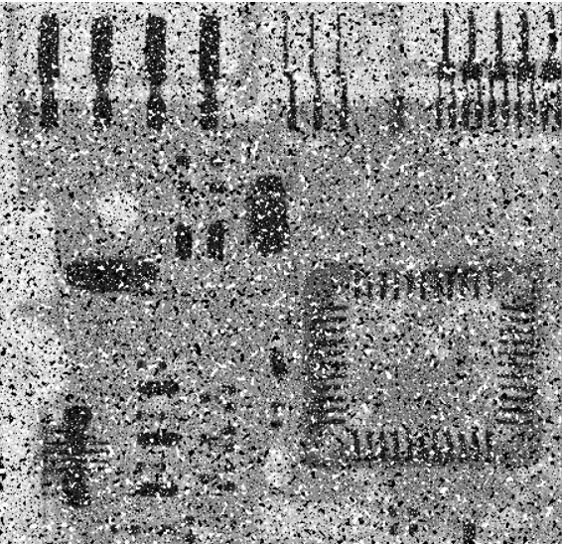
3c.) Noise Correction by Mode Filter (Image 4) :-
Original Image Edited Image

Slide 39
3c.) Noise Correction by Mode Filter (Image 7) :-
Original Image Edited Image

